Slide 1
Data structures and algorithm
Queues
Dr. Seemab Latif
Lecture No. 7
27th October, 2010

Slide 2
Queues
A Queue is a special kind of list, where items are inserted at one end (the rear) And deleted at the other end (the front).
Accessing the elements of queues follows a First In First Out (FIFO) order.
Example
Like customers standing in a check-out line in a store, the first customer in is the first customer served.

Slide 3
Common Operations on Queues
FRONT(Q): Returns the first element on Queue Q.
ENQUEUE(x,Q): Inserts element x at the end of Queue Q.
DEQUEUE(Q): Deletes the first element of Q.
ISEMPTY(Q): Returns true if and only if Q is an empty queue.
ISFULL(Q): Returns true if and only if Q is full.

Slide 4

Enqueue and Dequeue
Primary queue operations: Enqueue and Dequeue
Enqueue – insert an element at the rear of the queue.
Dequeue – remove an element from the front of the queue.

Slide 5
Queues Implementations
Static
Queue is implemented by an array, and size of queue remains fix
Dynamic
A queue can be implemented as a linked list, and expand or shrink with each enqueue or dequeue operation.

Slide 6
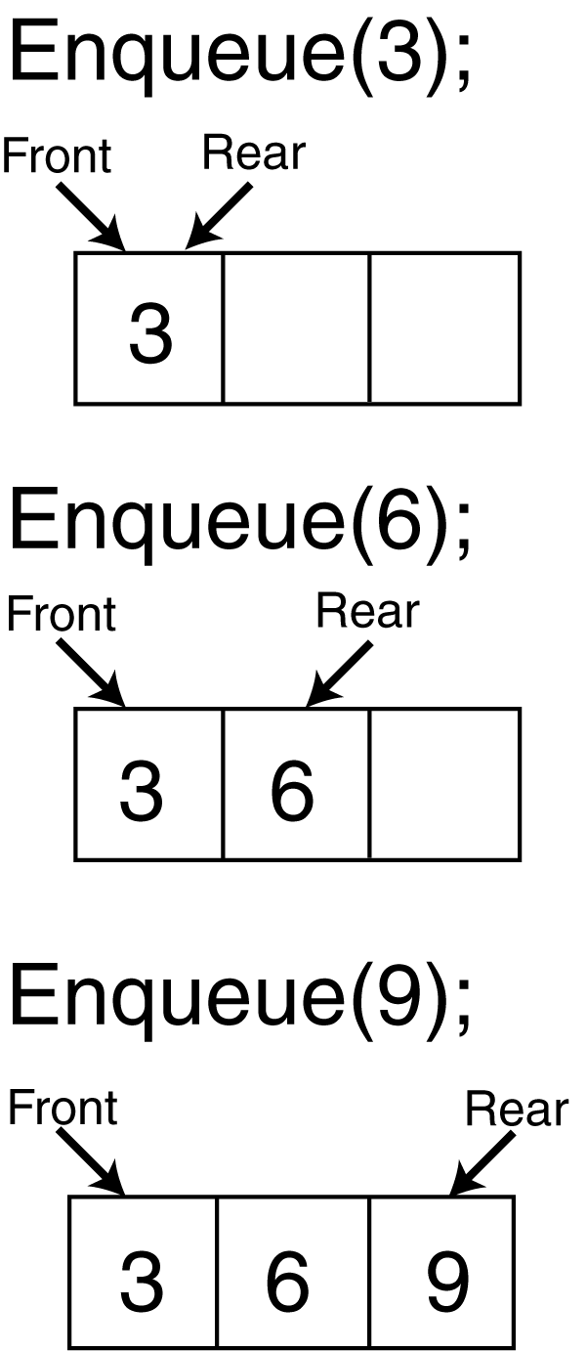
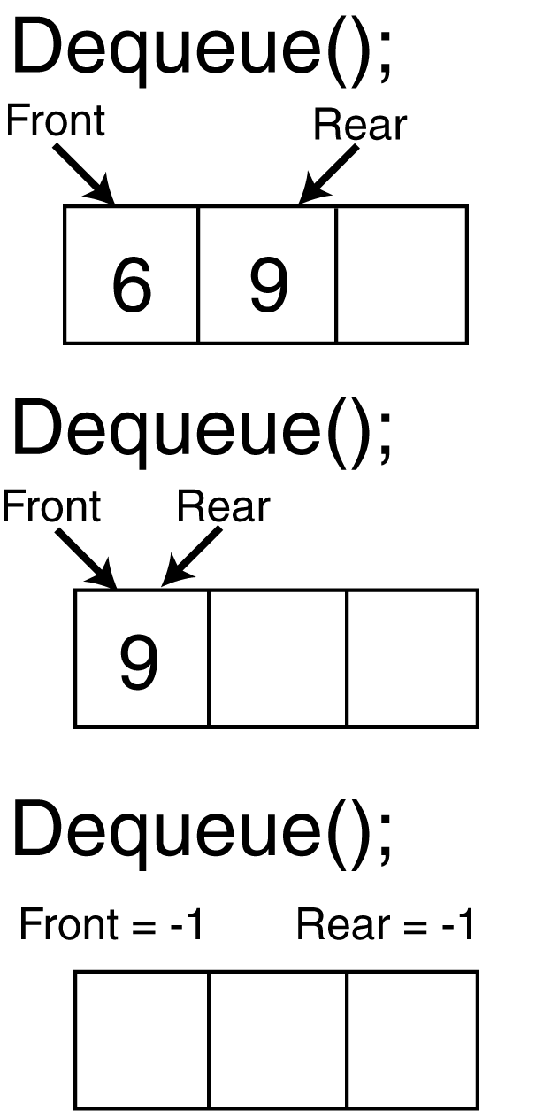
Static Implementation of Queues

Slide 7
Dynamic Implementation of Queues
Dynamic implementation is done using pointers.
FRONT: A pointer to the first element of the queue.
REAR: A pointer to the last element of the queue.
.
Front
x
y
z
Rear

Slide 8
Dynamic Implemenatation
Enqueue (X)
Enqueue (Y)
x
.
Q.front
Q.Rear
x
y
.
Q.front
Q.Rear

Slide 9
Dynamic Implementation
Dequeue
MakeNULL
y
.
Q.front
Q.Rear
NULL
Q.front
Q.Rear

Slide 10
Dynamic implementation of Queue
public:
DynQueue();
~DynQueue();
void enqueue();
void dequeue();
bool isEmpty();
void displayQueue();
void makeNull();
};
class DynQueue{
private:
struct queueNode
{
int num;
queueNode *next;
};
queueNode *front;
queueNode *rear;

Slide 11
Constructor
DynQueue::DynQueue()
{
front = NULL;
rear = NULL;
}

Slide 12
Enqueue( ) Function
void DynQueue::enqueue()
{
queueNode *ptr;
ptr = new queueNode;
cout<<"Enter Data";
cin>>ptr->num;
ptr->next= NULL;
if (front == NULL)
{
front = ptr;
rear = front;
}
else{
rear->next=ptr;
rear = ptr;
}
}

Slide 13
Dequeue( ) Function
void DynQueue::dequeue()
{
queueNode *temp;
temp = front;
if(isEmpty())
cout<<"Queue is Empty";
else
{
cout<<"data deleted="<<temp->num;
front = front->next;
delete temp;
}
}

Slide 14
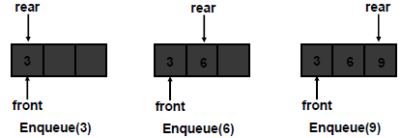
Static Implementation of Queue
Static implementation is done using arrays
In this implementation, we should know the exact number of elements to be stored in the queue.
When enqueuing, the front index is always fixed and the rear index moves forward in the array.

Slide 15
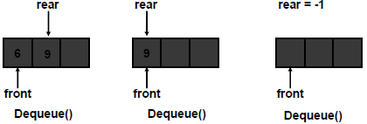
Static Implementation of Queue
When dequeuing, the front index is fixed, and the element at the front of the queue is removed. Move all the elements after it by one position. (Inefficient!!!)

Slide 16
Static Implementation of Queue
A better way
When an item is enqueued, the rear index moves forward.
When an item is dequeued, the front index also moves forward by one element
Example:
X = occupied, and O = empty
(front) XXXXOOOOO (rear)
OXXXXOOOO (after 1 dequeue, and 1 enqueue)
OOXXXXXOO (after another dequeue, and 2 enqueues)
OOOOXXXXX (after 2 more dequeues, and 2 enqueues)
The problem here is that the rear index cannot move beyond the last element in the array.

Slide 17
Static Implementation of Queue
To overcome the above limitation, we can use circular array implementation of queues.
In this implementation, first position follows the last.
When an element moves past the end of a circular array, it wraps around to the beginning, e.g
OOOOO7963 ->4OOOO7963 (after Enqueue(4))
After Enqueue(4), the rear index moves from 3 to 4.
How to detect an empty or full queue, using a circular array algorithm?
Use a counter of the number of elements in the queue.

Slide 18
Circular Queue
Q.rear
Q.rear
Q.front
Q.rear
Q.front
i
i
h
a
g
b
f
c
e
d
A Completely
Filled Queue
A Queue with
Only 1 Element

Slide 19
Circular Queue Implementation
class CirQueue
{
private:
int queue[5];
int rear;
int front;
int maxSize;
int counter;
public:
CirQueue();
void enqueue();
void dequeue();
bool isEmpty();
bool isFull();
void display();
};

Slide 20
Constructor
CirQueue::CirQueue()
{
front = 0;
rear = -1;
maxSize = 5;
counter =0;
}

Slide 21
Enqueue( ) Function
void CirQueue::enqueue()
{
if ( isFull())
cout<<"queue is full";
else
{
rear = (rear + 1) % maxSize;
cout<<"Enter Data=";
cin>> queue[rear];
counter ++;
}
}

Slide 22
Dequeue( ) Function
void CirQueue::dequeue()
{
if ( isEmpty())
cout<<"Queue is empty";
else
{
cout<< "Element deleted="<<queue[front];
front = (front +1)% maxSize;
counter --;
}
}

Slide 23
Display( ) Function
void CirQueue::display()
{
if(isEmpty())
cout<<"Queue is empty";
else
{
for (int i=0; i<counter; i++)
cout<< queue[(front+ i)% maxSize]<<endl;
}
}

Slide 24
isEmpty( ) and isFull( )
bool CirQueue::isEmpty()
{
if (counter == 0)
return true;
else
return false;
}
bool CirQueue::isFull()
{
if (counter < maxSize)
return false;
else
return true;
}

Slide 25
Priority Queues
A priority queue is a data structure in which prioritized insertion and deletion operations on elements can be performed according to their priority values.
There are two types of priority queues:
Ascending Priority queue, and a
Descending Priority queue

Slide 26
Introduction
Stack and Queue are data structures whose elements are ordered based on a sequence in which they have been inserted
E.g. pop() function removes the item pushed last in the stack
Intrinsic order among the elements themselves (e.g. numeric or alphabetic order etc.) is ignored in a stack or a queue

Slide 27
Types of Priority Queue
Ascending Priority queue: a collection of items into which items can be inserted randomly but only the smallest item can be removed
If “A-Priority-Q” is an ascending priority queue then
Enqueue() will insert item ‘x’ into A-Priority-Q,
minDequeue() will remove the minimum item from A-Priority-Q and return its value

Slide 28
Types of Priority Queue
Descending Priority queue: a collection of items into which items can be inserted randomly but only the largest item can be removed
If “D-Priority-Q” is a descending priority queue then
Enqueue() will insert item x into D-Priority-Q,
maxDequeue( ) will remove the maximum item from D-Priority-Q and return its value

Slide 29
Generally
In both the above types, if elements with equal priority are present, the FIFO technique is applied.
Both types of priority queues are similar in a way that both of them remove and return the element with the highest “Priority” when the function remove() is called.
For an ascending priority queue item with smallest value has maximum “priority”
For a descending priority queue item with highest value has maximum “priority”
This implies that we must have criteria for a priority queue to determine the Priority of its constituent elements.
the elements of a priority queue can be numbers, characters or any complex structures such as phone book entries, events in a simulation

Slide 30
Priority Queue Issues
In what manner should the items be inserted in a priority queue
Ordered (so that retrieval is simple, but insertion will become complex)
Arbitrary (insertion is simple but retrieval will require elaborate search mechanism)
Retrieval
In case of un-ordered priority queue, what if minimum number is to be removed from an ascending queue of n elements (n number of comparisons)
In what manner should the queue be maintained when an item is removed from it
Emptied location is kept blank (how to recognize a blank location ??)
Remaining items are shifted

